Slide 1
Health Insurance Cross Sell Prediction
By Gizka Oivia Septika Putri

Slide 2
BUSINESS UNDERSTANDING
Our client is an Insurance company that has provided Health Insurance to its customers now they need your help in building a model to predict whether the policyholders (customers) from past year will also be interested in Vehicle Insurance provided by the company.
An insurance policy is an arrangement by which a company undertakes to provide a guarantee of compensation for specified loss, damage, illness, or death in return for the payment of a specified premium. A premium is a sum of money that the customer needs to pay regularly to an insurance company for this guarantee.
Just like medical insurance, there is vehicle insurance where every year customer needs to pay a premium of certain amount to insurance provider company so that in case of unfortunate accident by the vehicle, the insurance provider company will provide a compensation (called ‘sum assured’) to the customer.
Objectives :
Building a model to predict whether a customer would be interested in Vehicle Insurance is extremely helpful for the company because it can then accordingly plan its communication strategy to reach out to those customers and optimise its business model and revenue.

Slide 3
Outline
DATA description
DATA
UNDERSTANDING
01
02
03
04
conclusion
Machine learning
model

Slide 4
01 DATA DESCRIPTION
Data Source: Kaggle - Health Insurance Cross Sell Prediction
feature | description
id | Unique ID for the customer
Gender | Gender of the customer
Age | Age of the customer
Driving_ License | 1: Customer already has DL, 0: Customer does not have DL
Region_ Code | Unique code for the region of the customer
Previously_ Insured | 1: Customer already has Vehicle Insurance, 0: Customer doesn't have Vehicle Insurance
Vehicle_ Age | Age of the Vehicle
feature | description
Vehicle_ Damage | 1: Customer got his/her vehicle damaged in the past, 0: Customer didn't get his/her vehicle damaged in he past
Annual_ Premium | The amount customer needs to pay as premium in the year
PolicySales Channel | Anonymised Code for the channel of outreaching to the customer ie. Different Agents, Over Mail, Over Phone, In Person, etc
Vintage | Number of Days, Customer has been associated with the company
Response | 1 : Customer is interested, 0 : Customer is not interested

Slide 5
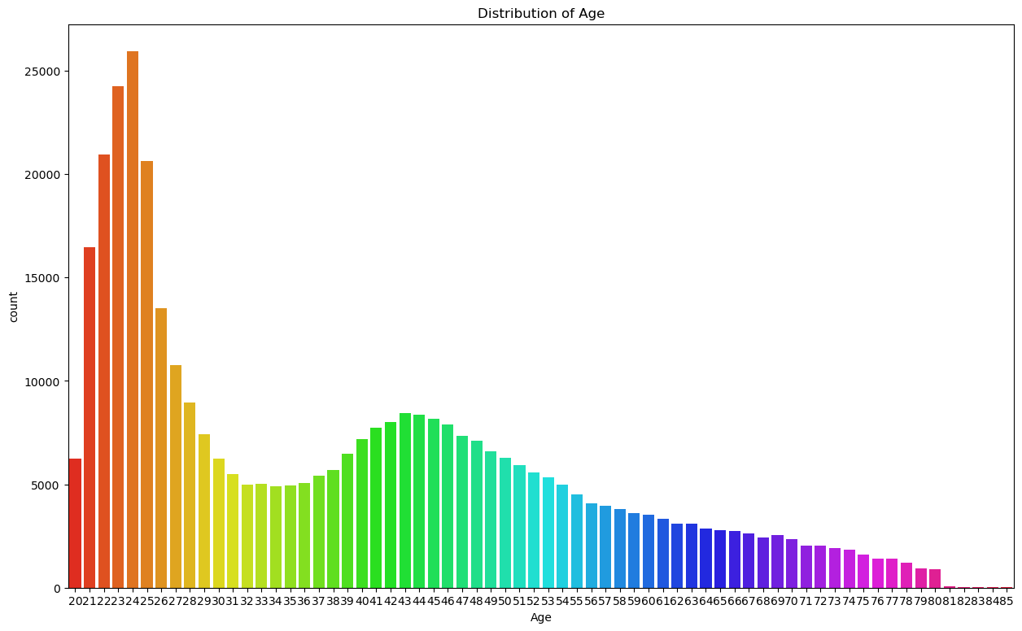
DATA UNDERSTANDING
The top age customer is 24 years old. The distribution of age is skewed, it can be defined that young people are more interested in buying insurance

Slide 6
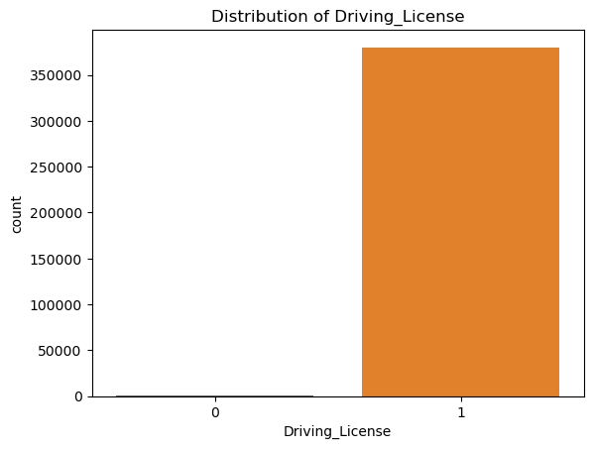
DATA UNDERSTANDING
Almost all customers have a Driver_License

Slide 7
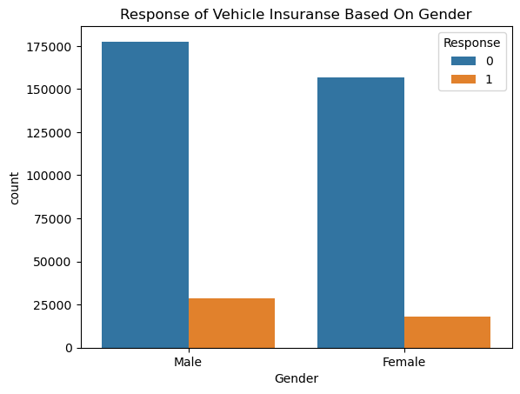
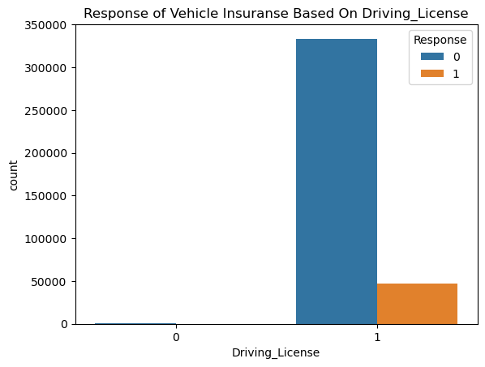
DATA UNDERSTANDING
Male are slightly more interested using vehicle insurance, but the number is small compared to the overall data, so we can't make any direct conclusions based on gender.
Customers who are interested in vehicle insurance are those who have a driver license.

Slide 8
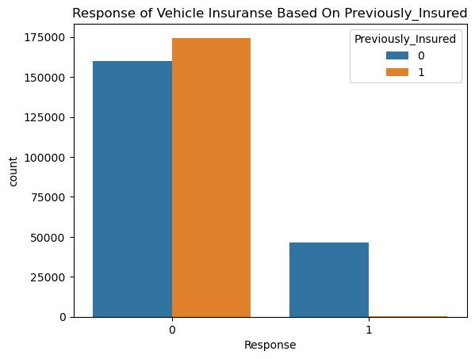
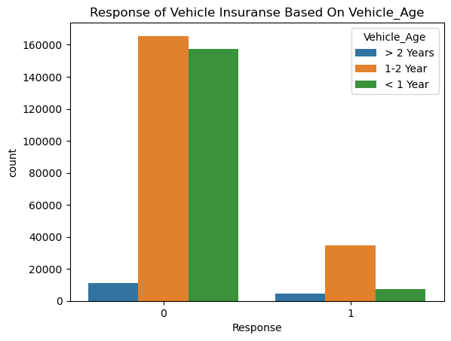
DATA UNDERSTANDING
Customers who do not have vehicle insurance are interested in buying it, and there are no customers who want to buy other vehicle insurance.
The most customers who are interested in buying insurance are customers who have vehicles aged between 1-2 years

Slide 9
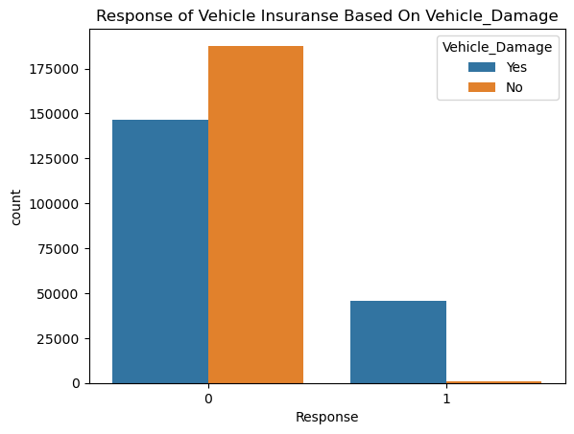
DATA UNDERSTANDING
Customers who have damaged vehicles are interested in buying insurance

Slide 10
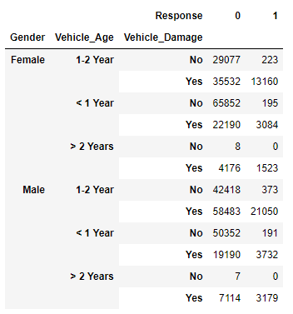
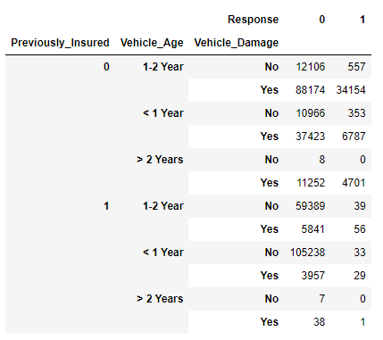
DATA UNDERSTANDING

Slide 11
DATA UNDERSTANDING
The customers who are most interested in buying insurance are male who are 1-2 years old and have vehicle damage
If the vehicle is no-previously insured, customers who have damaged vehicles in any age range will be interested in buying insurance.
Vehicles that are > 2 years and no-previously insured will be interested for insurance
If the vehicle is > 2 years old and has not been damaged, then choose not to do insurance at all
Vehicles that are > 2 years old and have been insured are not interested at all for insurance anymore, even though the vehicle is damaged.

Slide 12
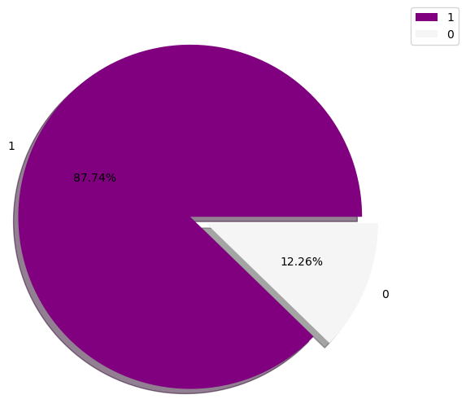


Machine learning model
The number of Yes-Response and No-Response is imbalanced
So we can undersampling for this large dataset
Before undersampling
After undersampling

Slide 13
Comparison of Evaluation Models
Based on the modeling evaluation, the best f1 score is given by Random Forest, so we will develop a model using Random Forest
MODEL | F1 Score
Decision Tree Classifier (Baseline Model) | 0.29
Decision Tree Classifier | 0.71
K Neighbors Classifier | 0.60
Random Forest Classifier | 0.80
Gaussian Naïve Bayes | 0.79

Slide 14
Random Forest with Hyperparameter tuning
From the best model, then we perform hyperparameter tuning into Random Forest
Result of yperparatemer Tunning into the model:
model | F1 score
Random Forest Classifier | 0.80
Random Forest Classifier with Hyperparameter Tuning | 0.82

Slide 15
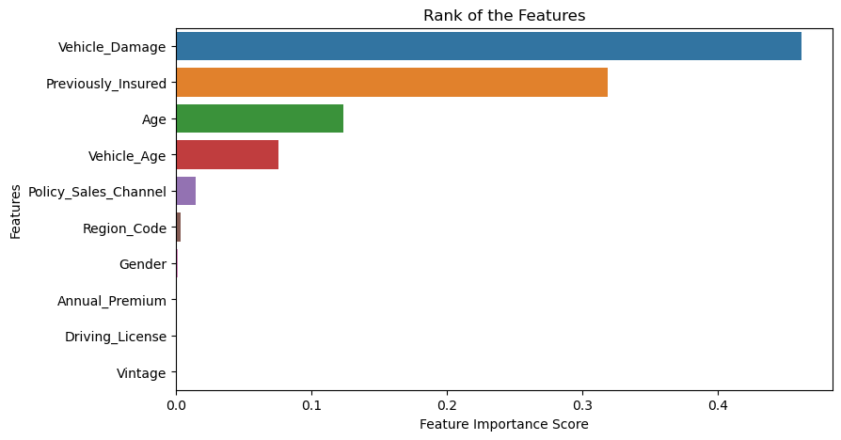
Feature importance

Slide 16
CONCLUSION
Question 1: Find which features has high contribution
Vehicle_Damage, Previosly_Insurance, Age, and Vehicle Age
Question 2: Find the best model to predict the Response of Vehicle Insurance
The best analytical model to predict the response of Vehicle Insurance is Random Forest with F1 Score 0,80.
Hyperparameter tuning in random forest increase the F1 Score to 0,82.
Question 3: Find the factors that make customers buy vehicle insurance
Customers who have uninsured and damaged vehicles are more interested in buying insurance
When the vehicle is 1-2 years, the customer will insure it. Meanwhile, vehicles that are > 2 years definitely insured.
The older the customer, the less interested they are in insuring their vehicle.

Slide 17
Recommendation
The company can reach customers who are under 30 years old, so that customers are not burdened with premium fees. This is because the younger the customer, the cheaper the premium to be paid.
The company does not need to focus on customers who already have vehicle insurance, because customers who have insured their vehicles are no longer interested in buying insurance.
The company can provide an approach to customers who have vehicles that are more than 2 years old and have not insured their vehicles.

Slide 18
THANK YOU

